Slide 1


Slide 2

Online Examination system
M. Ahsan Shahid 18-NTU-CS-1052
M. Umer 18-NTU-CS-1049

Slide 3
Problem Statement
During the Covid-19 outbreak last year many educational institutes were conducting online classes but there was no mode of conducting online exams thus, had to promote the students instead. Also, it involves the use of traditional ways which was difficult to manage, and a lot of manpower was required to monitor and invigilate the students and the exams which is a time-consuming task. Furthermore, the result declaration was not rapid as we've faced recently during the Intermediate-II results.

Slide 4
Introduction
Online Examination System (OES) is a technology-driven website It is a way to simplify examination activities like defining exam patterns, defining exam timer, objective sections, conducting exams using the computer or mobile devices in a paperless manner. It keeps all the record of the teachers and student and their respected activities.
This project assesses students by conducting online objective tests. The tests would be highly customizable. This project will enable educational institutes to conduct test and have automated checking of answers based on the response by the candidates. It faculties to create their own tests. It would enable educational institutes to perform tests, quiz and create feedback forms. It asks faculty to create his/her set of questions. The result of the response would be available to the faculty of the question set. This project would be helpful for creating practice tests, say for educational institutes and as a feedback form.

Slide 5
Purpose
The purpose of developing this website is as follows:
Responses by the candidates will be checked automatically and instantly.
Online examination will reduce the hectic job of assessing the answers given by the candidates.
Being an integrated Online Examination System, it will reduce paperwork.
Can generate various reports almost instantly when and where required.

Slide 6
Objectives
Objectives of OES are as follows:
To facilitate exams controlling & monitoring.
To keep track of admin and student log.
To conduct more students’ exams at the same time.
To ease the checking of the exam.
More secure, less cheating.
It's convenient.

Slide 7
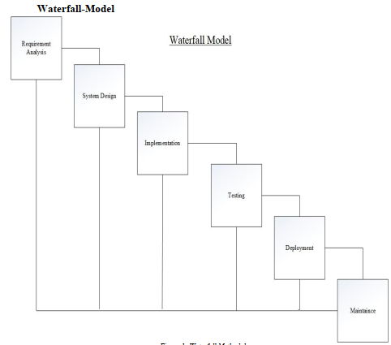
Methodology

Slide 8
Aspects
Admin Panel
Student Panel
Faculty Panel

Slide 9
Admin Panel Contents
Admin
Login
Admin Profile
Dashboard
Departments
Categories
Subjects
Students
Faculty
Notice
Export Database

Slide 10

Login

Slide 11
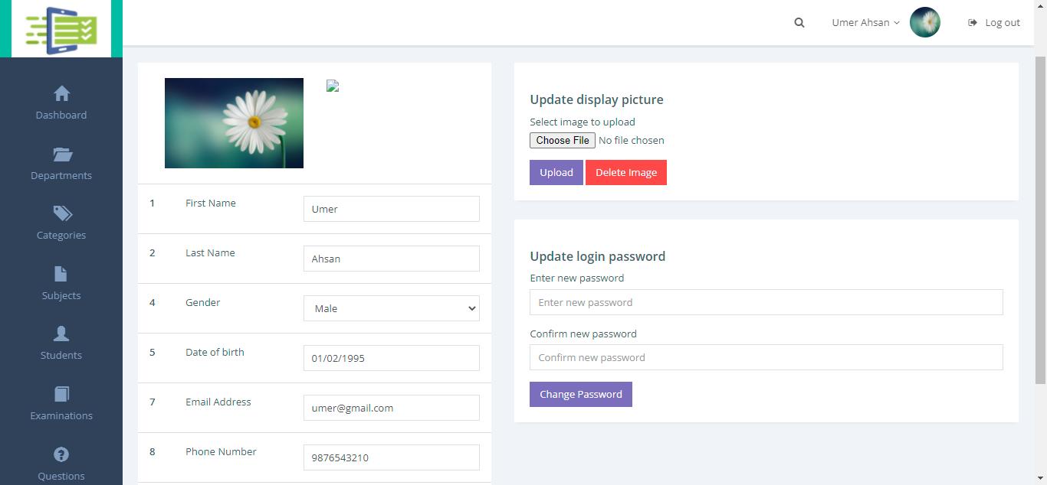
Admin Profile

Slide 12
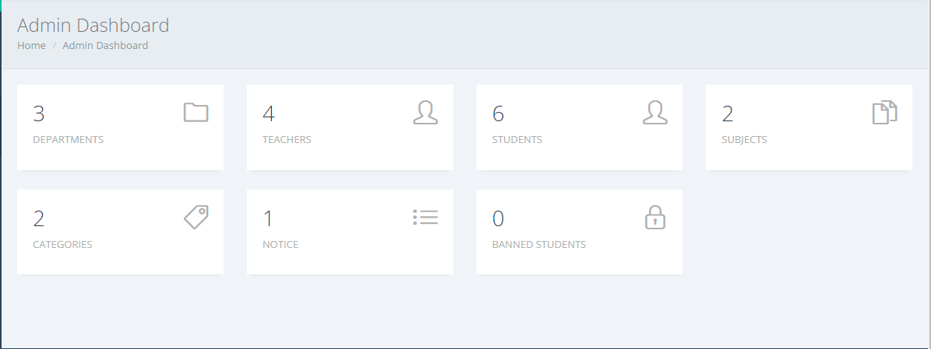
Dashboard

Slide 13
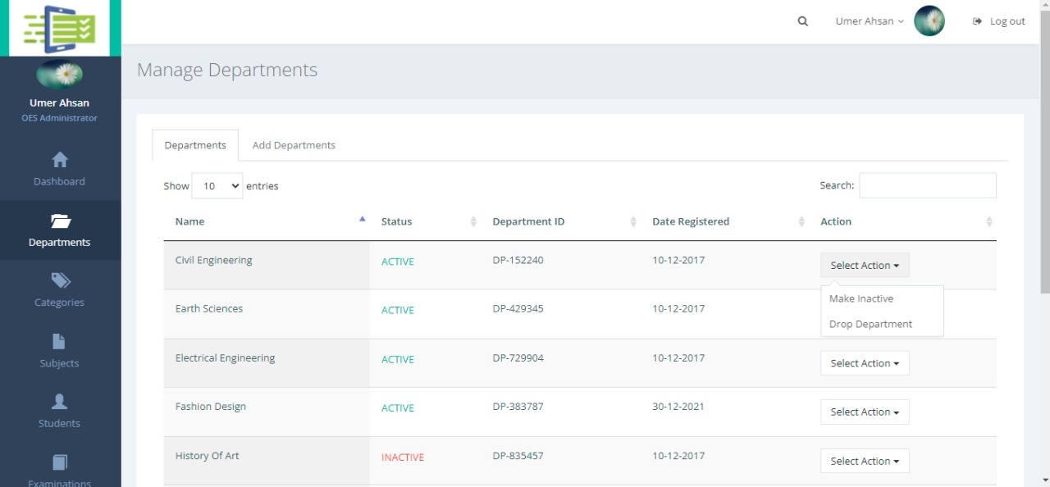
Departments

Slide 14
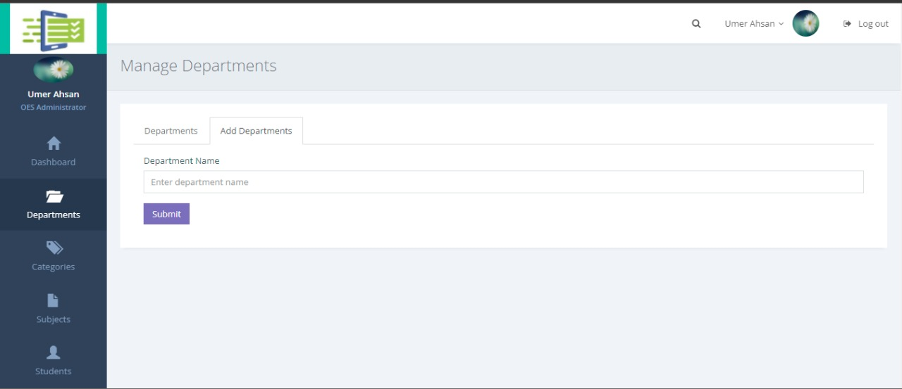
Add Departments

Slide 15
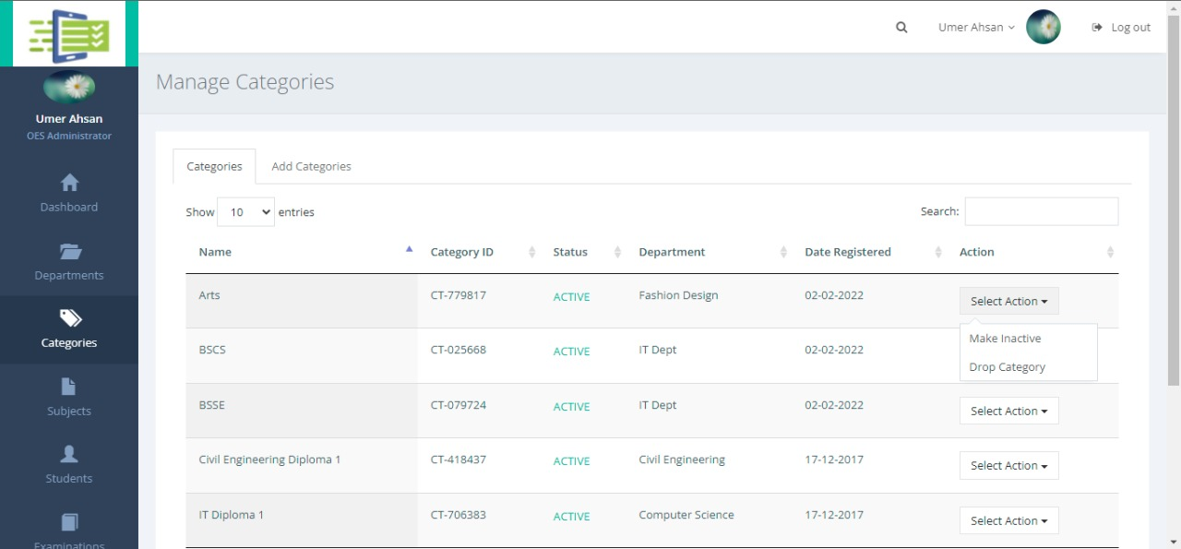
Categories

Slide 16
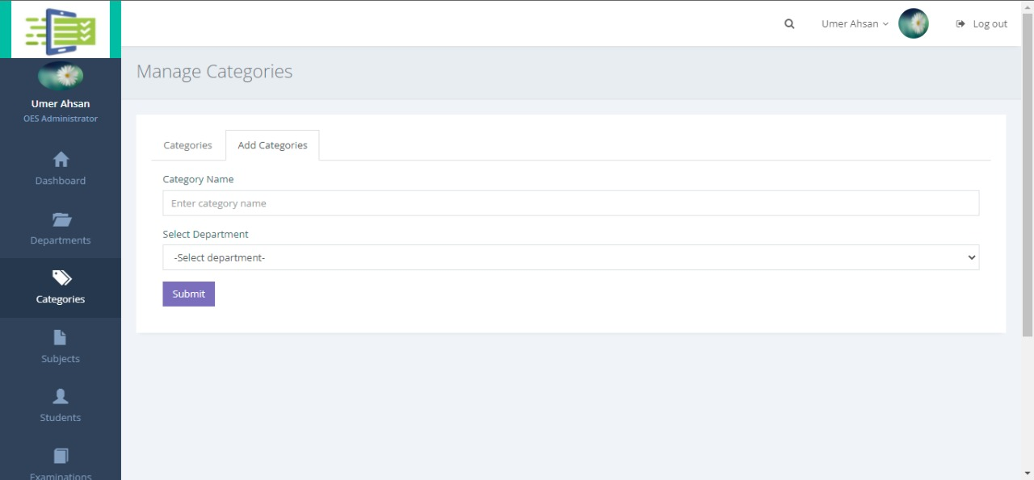
Add Categories

Slide 17
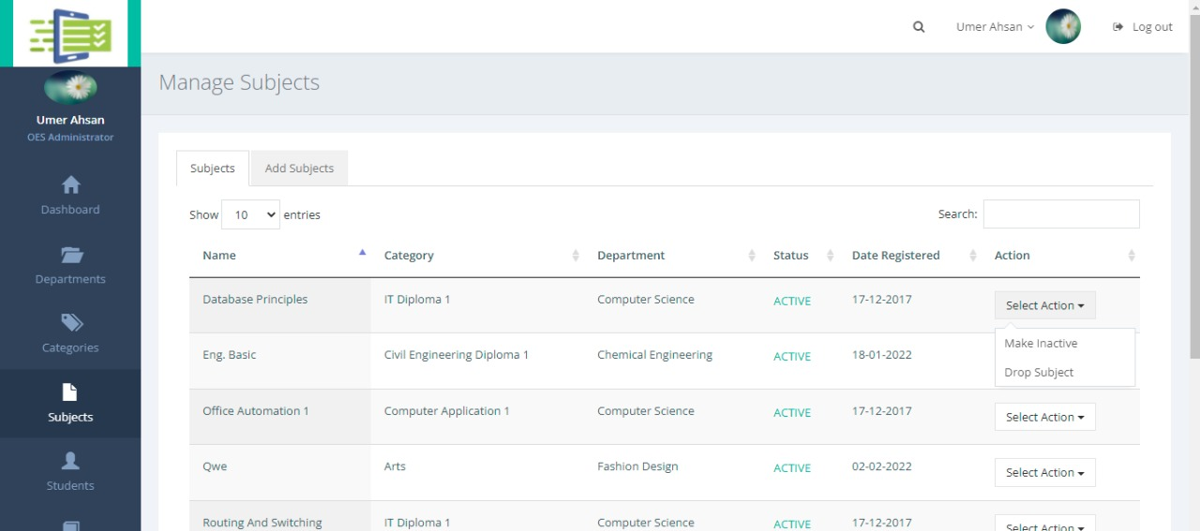
Subjects

Slide 18
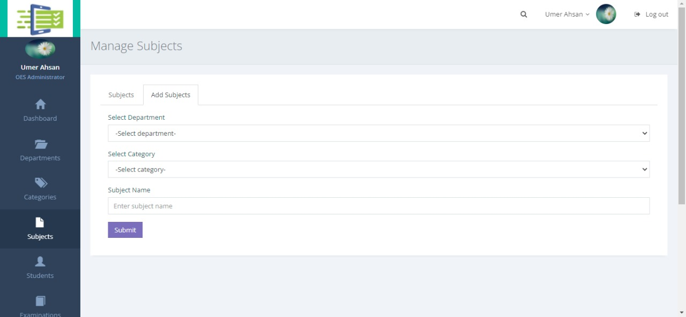
Add Subjects

Slide 19
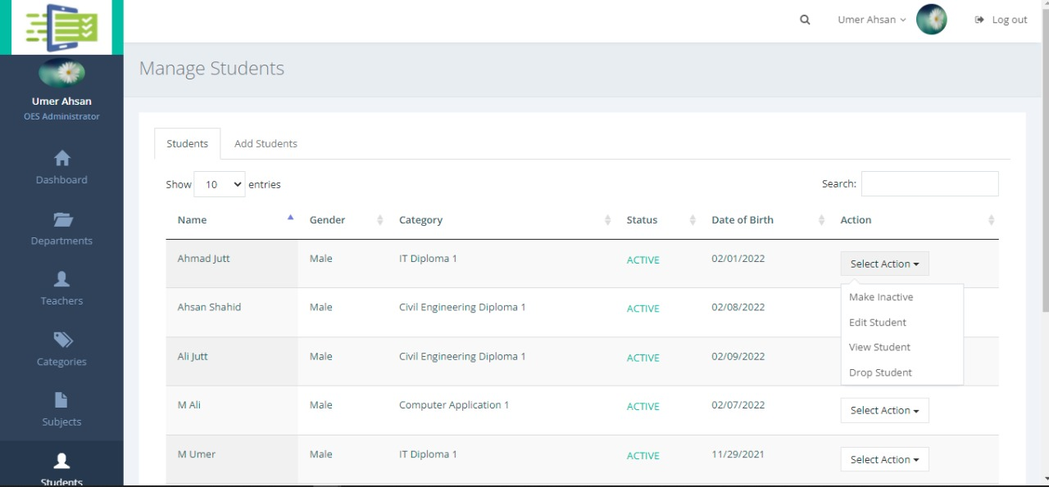
Students

Slide 20
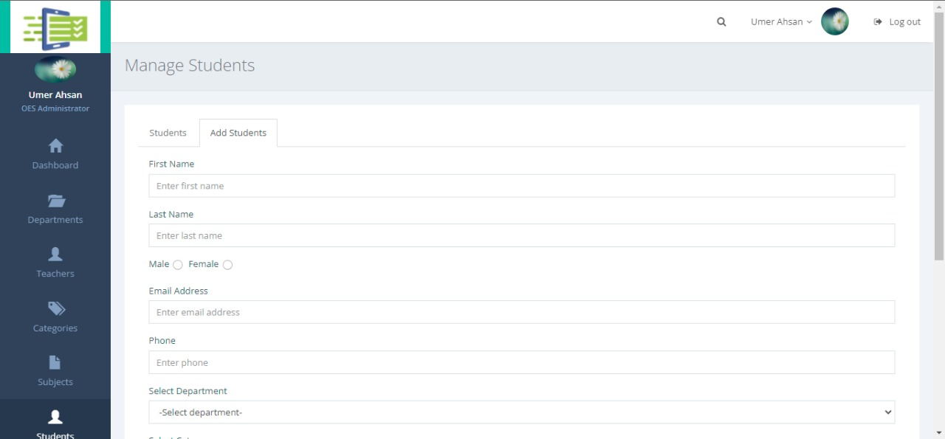
Add Students

Slide 21
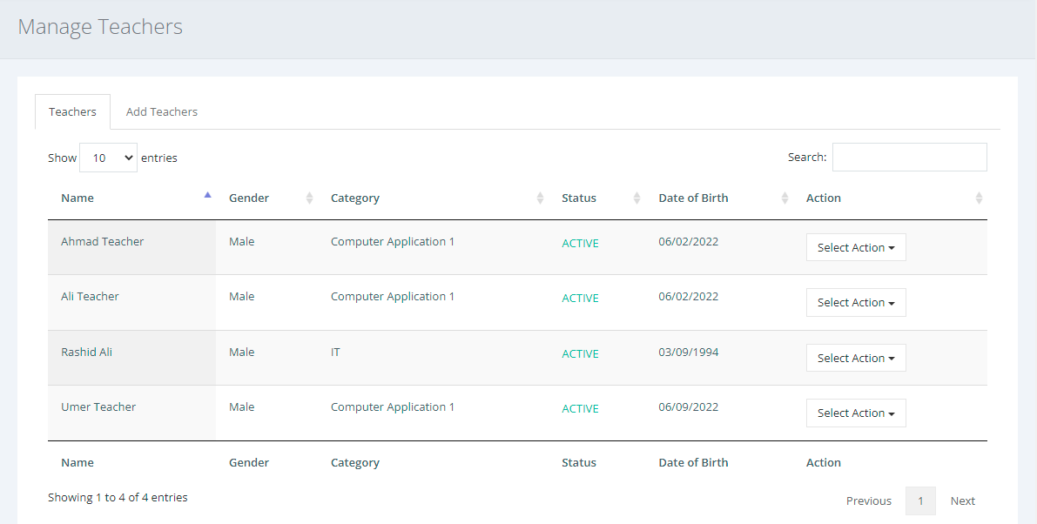
Faculty

Slide 22
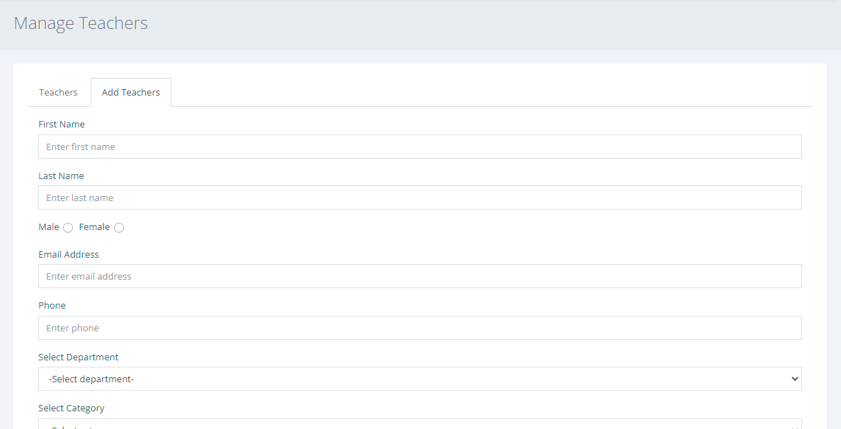
Add Faculty

Slide 23
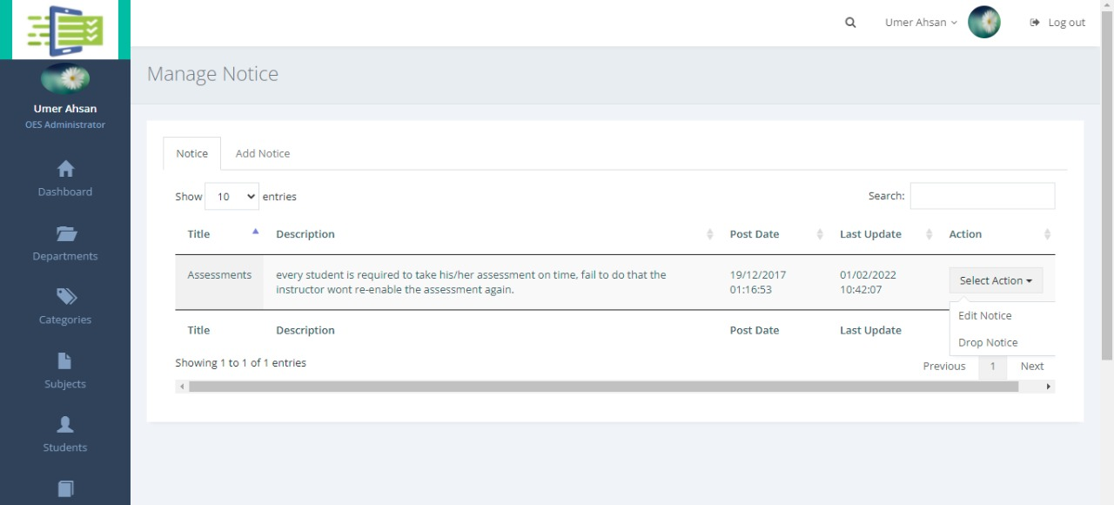
Notice

Slide 24
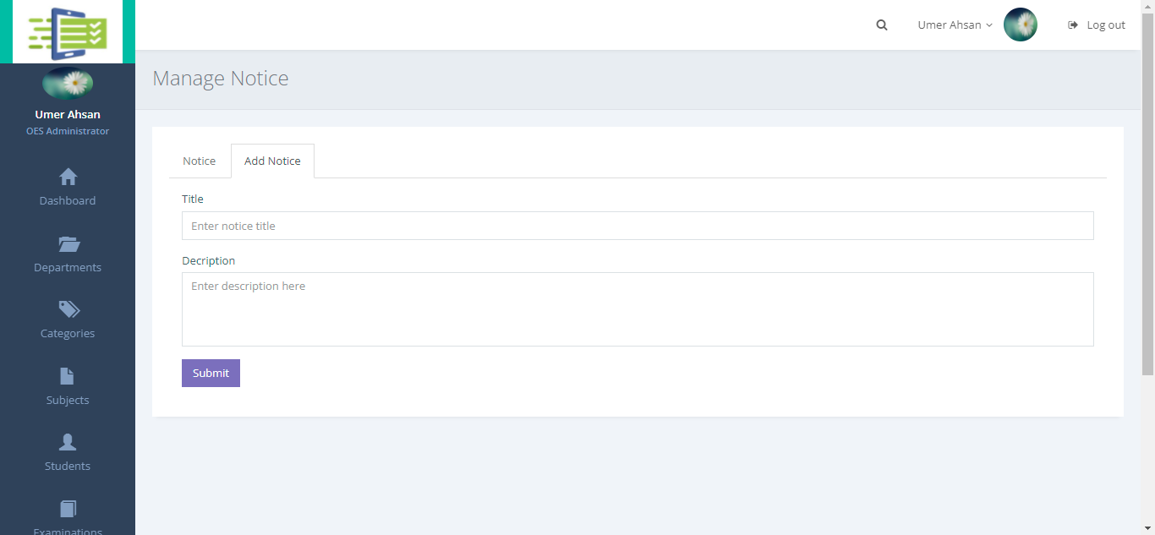
Add Notice

Slide 25
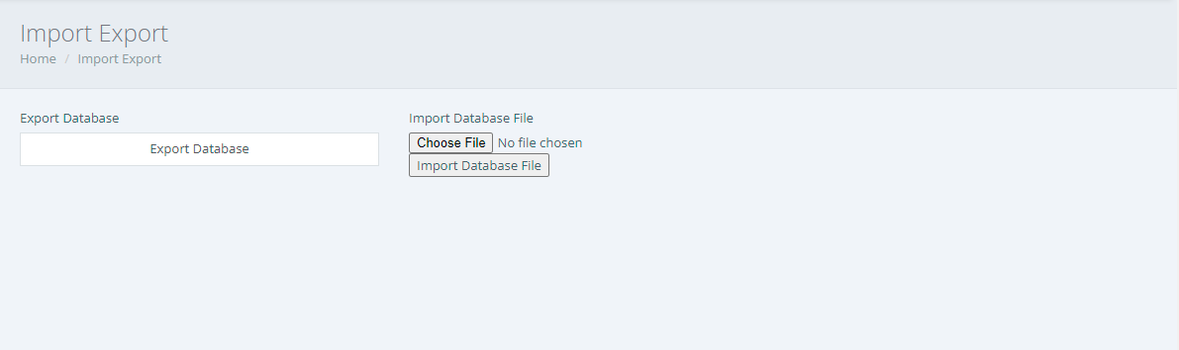
Export Database

Slide 26
Student Panel Contents
Student
Login
Student Profile
Dashboard
Subjects
Students
Examination
Exam Results

Slide 27
Login

Slide 28
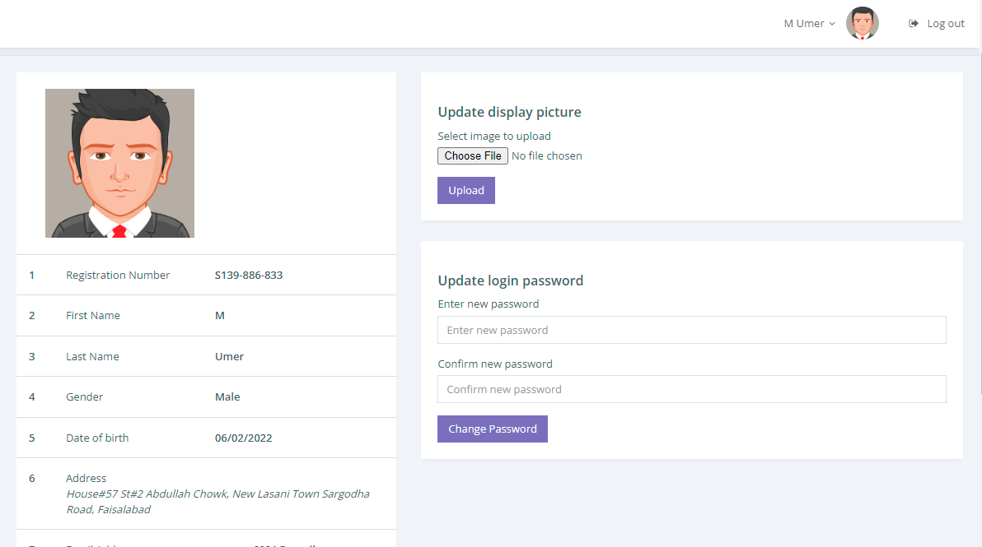
Student Profile

Slide 29
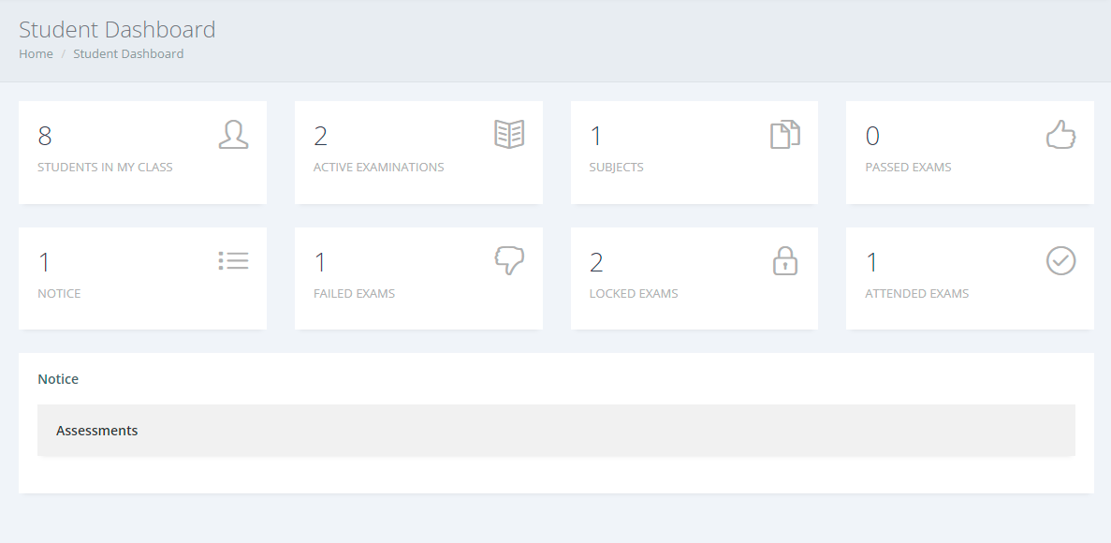
Dashboard

Slide 30
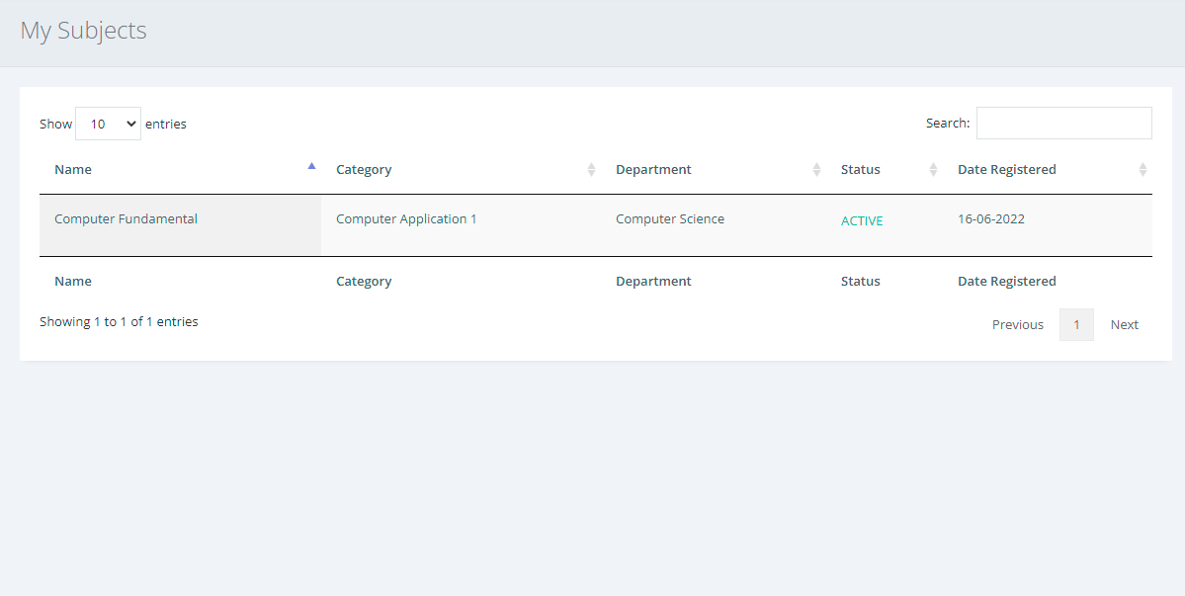
Subjects

Slide 31
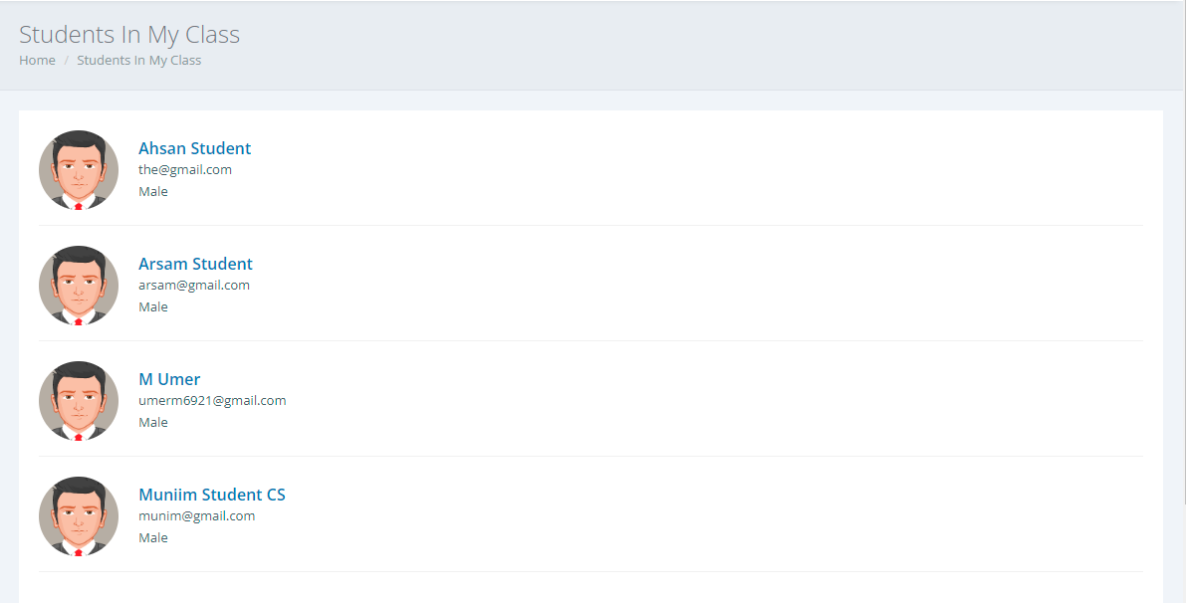
Students

Slide 32
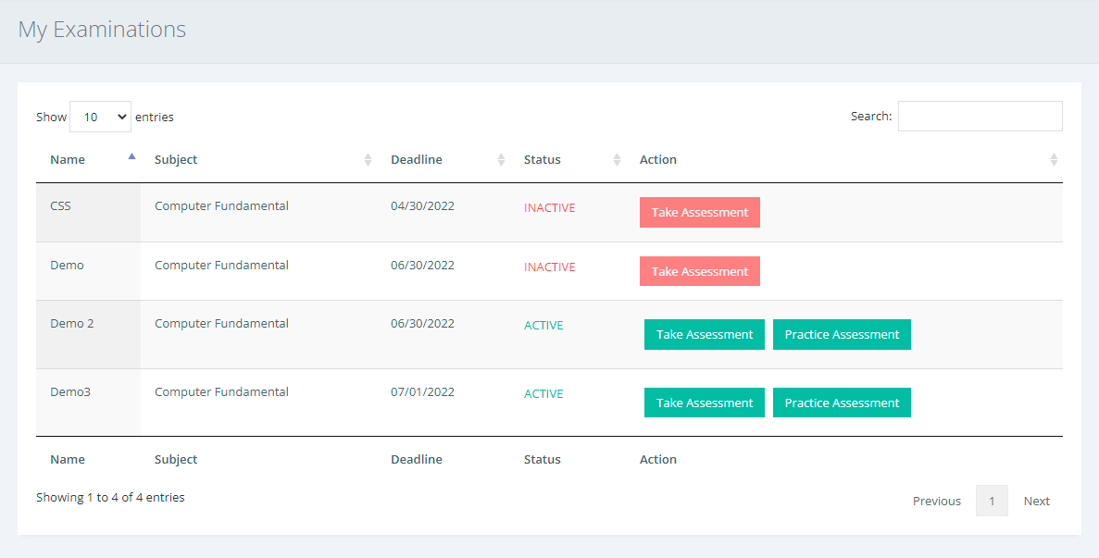
Examination

Slide 33
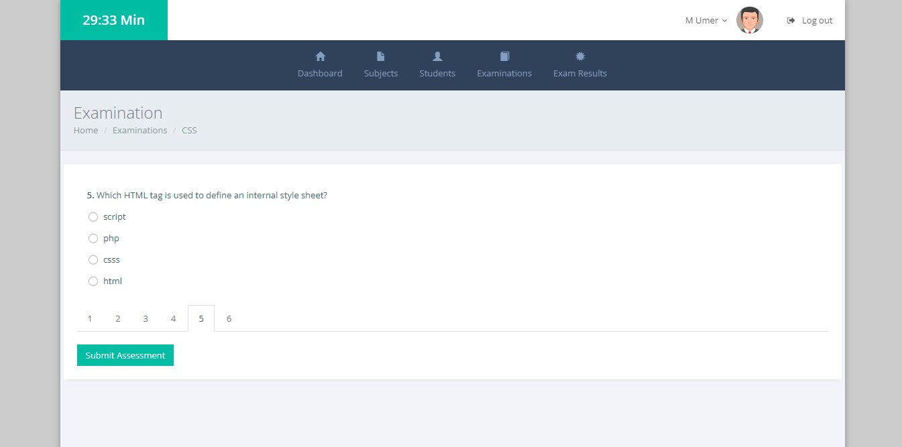
Examination

Slide 34
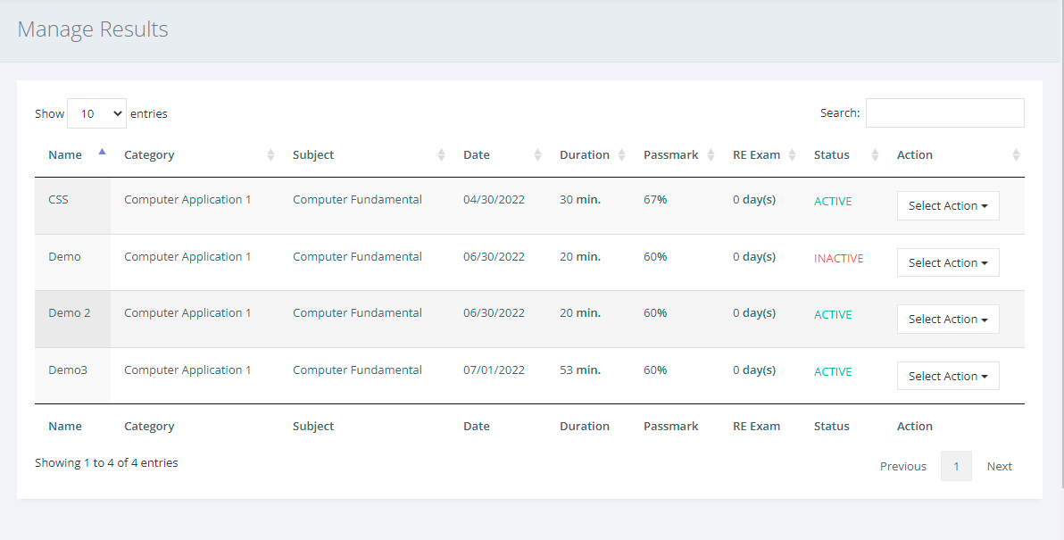
Exam Results

Slide 35
Faculty Panel Contents
Faculty
Faculty Profile
Dashboard
Subjects
Send Invitation
Candidates
Examination
Questions
Exam Result

Slide 36
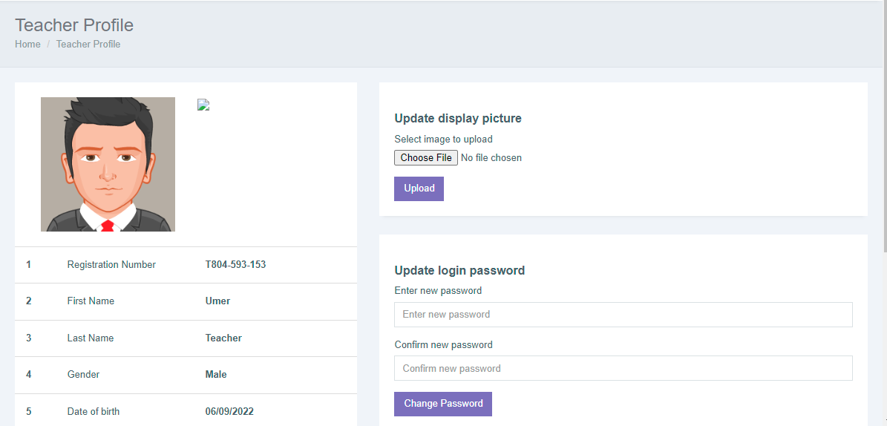
Faculty Profile

Slide 37
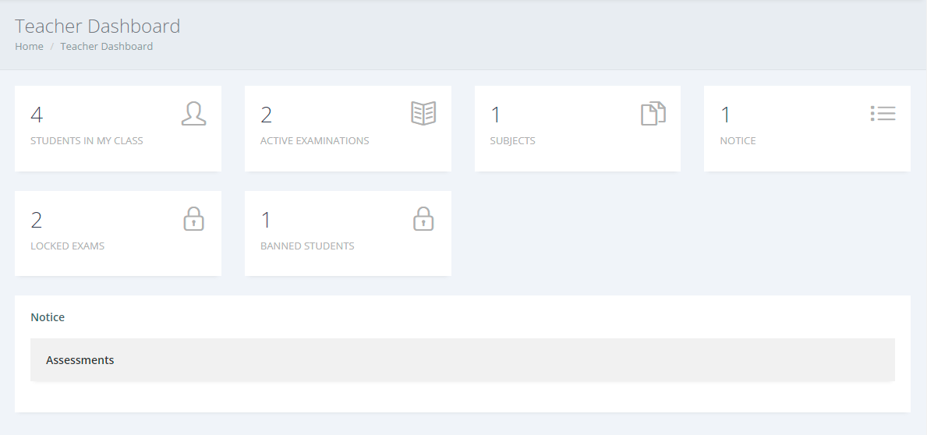
Dashboard

Slide 38
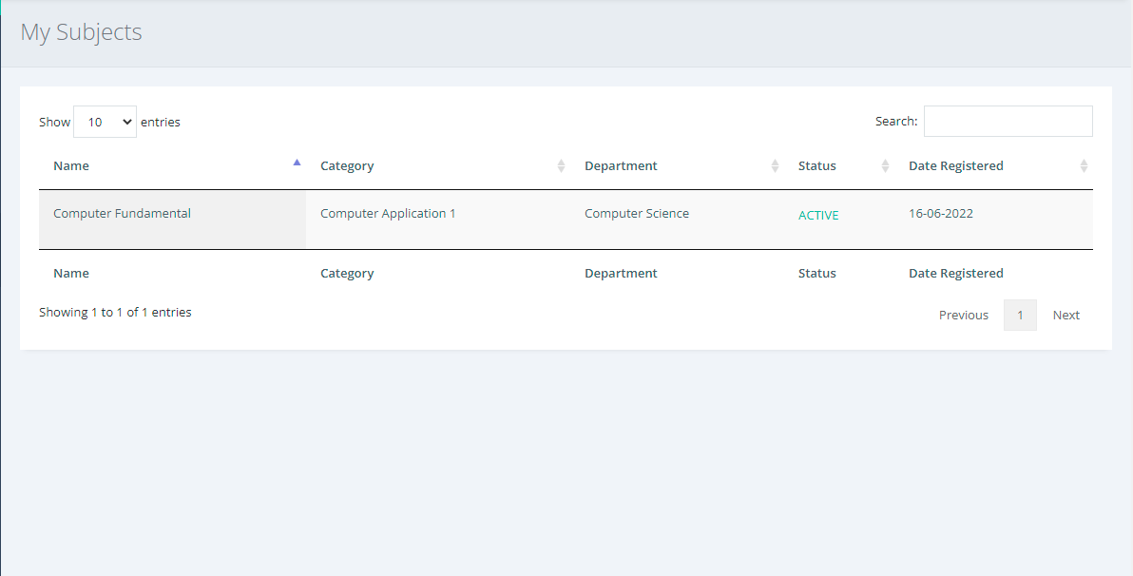
Subjects

Slide 39
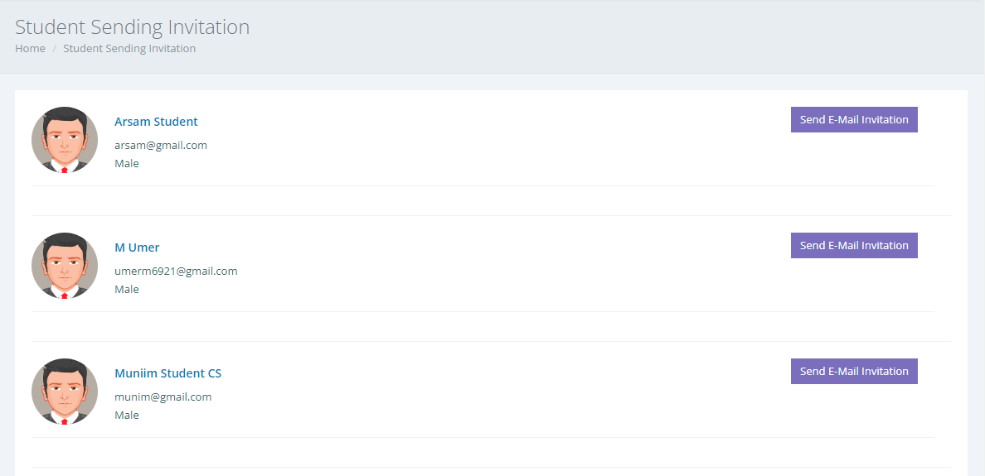
Send Invitation

Slide 40
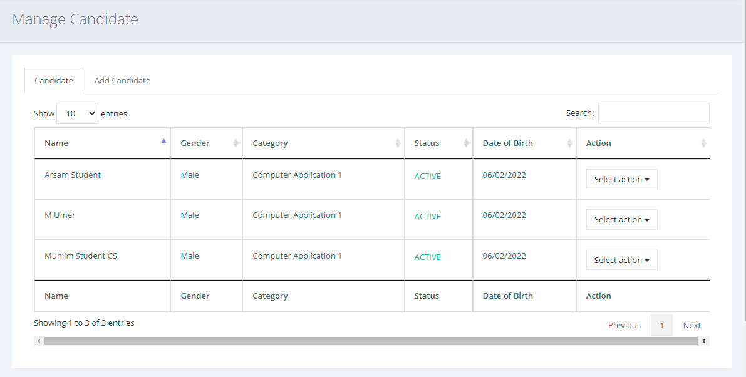
Candidates

Slide 41
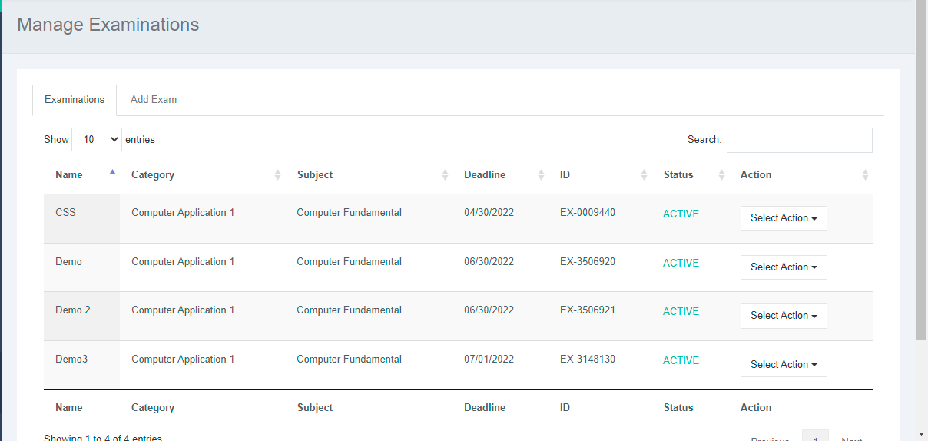
Examination

Slide 42
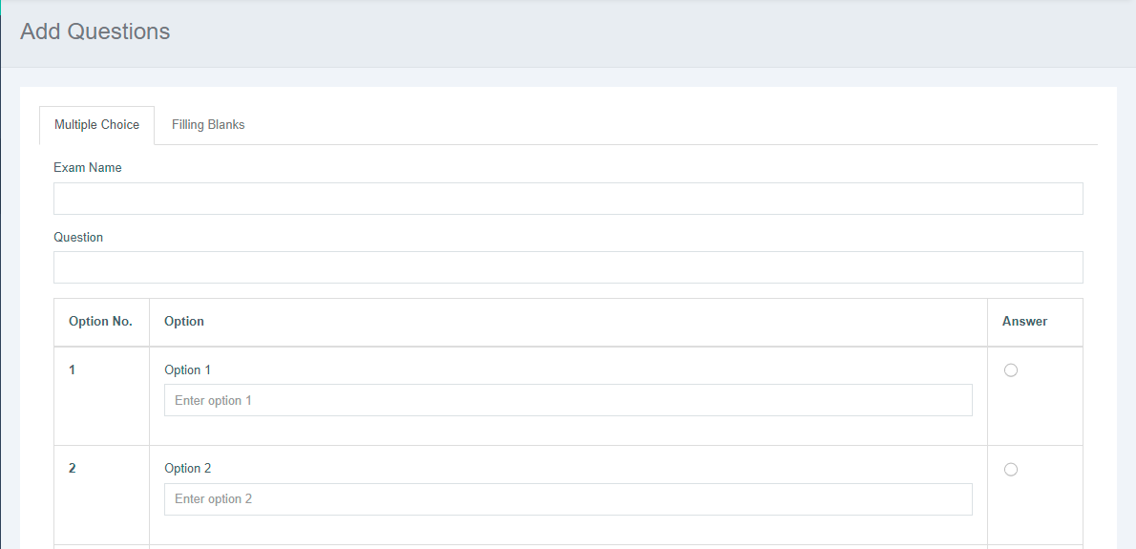
Questions

Slide 43
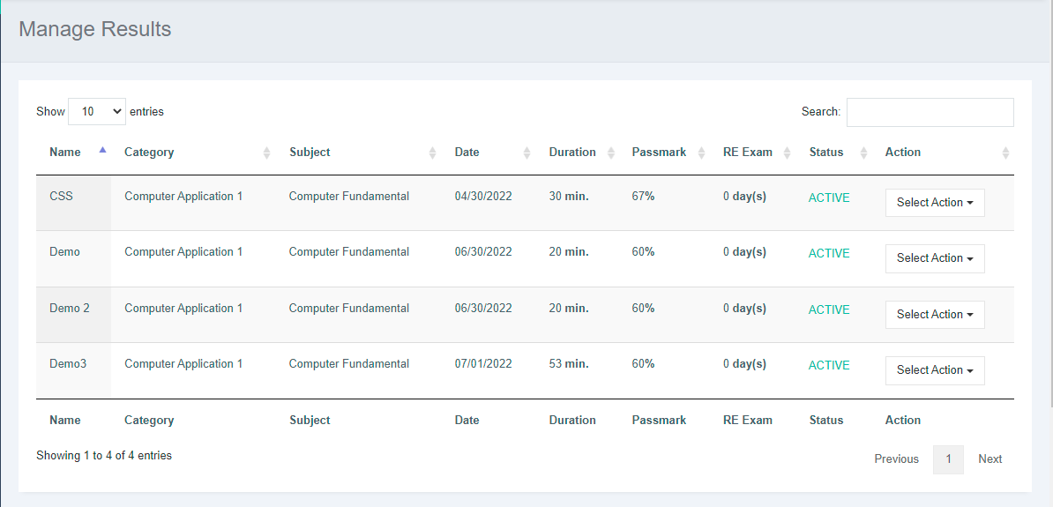
Exam Result

Slide 44


